Slide 1
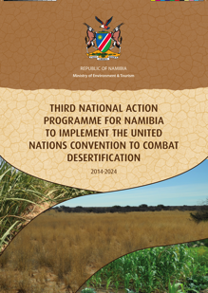
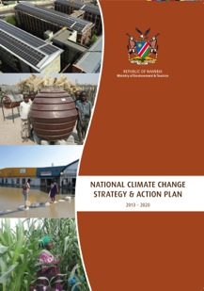

Namibia - Pursuing synergies in the implementation of the three Rio Conventions
2nd December 2015
UNFCCC COP21

Slide 2
Presentation Overview
Overview of Namibia
Linkages between biodiversity loss, climate change and desertification
Importance of synergies in Namibia
Institutional and policy framework for Rio Conventions
Awareness Raising
Monitoring and Evaluation
Examples of on-the-ground synergistic implementation
Way Forward

Slide 3
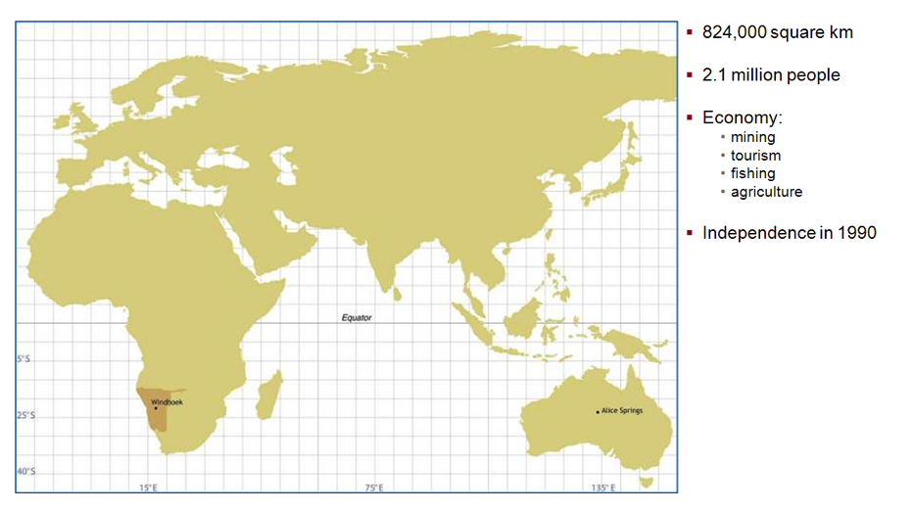
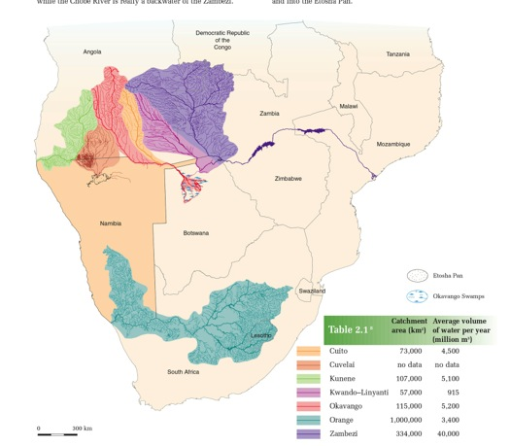
Namibia at a glance

Slide 4
Some key facts that heighten the need for synergies in Namibia
Namibia is the driest country South of the Sahara desert. Water is in critically short supply and the country is extremely vulnerable to drought events as well as desertification
Farming, through livestock rearing and crop cultivation, is practised on over 70% of the country’s landmass in spite of the country’s aridity
Namibia is home to rich populations of wildlife and plant resources with a protected area network covering approximately 45% of the country’s landmass. This is the basis of the tourism sector, which is the fastest growing sector of the economy
Majority of rural communities make use of firewood for their cooking and heating needs, which puts pressure on the country’s forest resources and creates need for alternative energy solutions
An estimated 26 million hectares of land is affected by bush encroachment, which is reducing the productivity of farmland and depleting underground water resources

Slide 5
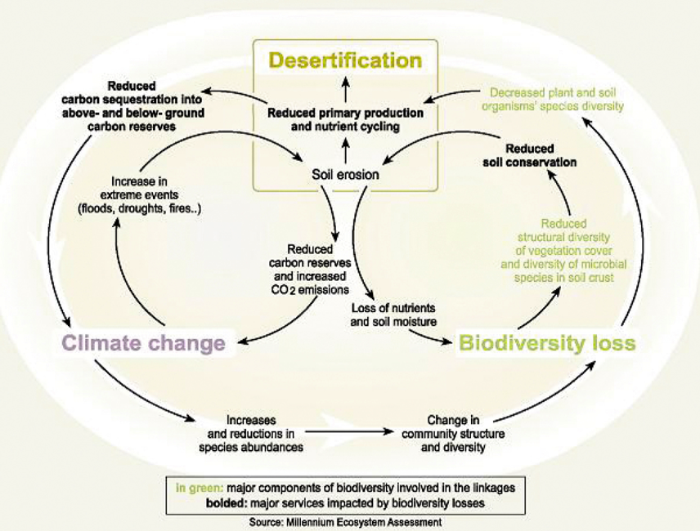
Linkages among desertification, climate change and biodiversity loss

Slide 6
Institutional and Policy Framework for Rio Conventions in Namibia
Division Multilateral Environmental Agreements,
Department of Environmental Affairs,
Ministry of Environment and Tourism

Slide 7
Institutional and Policy Framework for Rio Conventions in Namibia
Three cross-sectoral national level committees in place:
  National Climate Change Committee (since 2001)
  National Biodiversity Committee (since 2010)
  National Sustainable Land Management Committee (since 2015)
These committees guide and report back on the implementation of the Second National Biodiversity Strategy and Action Plan; National Climate Change Strategy and Action Plan; and the 3rd National Action Programme for the UNCCD
These instruments were jointly developed and launched in 2014
A number of other legislation, policies and programmes promote the integrated implementation of the Rio Conventions such as the National Rangeland Management Policy and Strategy (2012); Climate Smart Agriculture Programme (2015-2030) and the Access and Benefit Sharing Act of 2015

Slide 8
Awareness Raising
Number of joint programmes have been developed to raise awareness and build capacity on the three Rio Conventions
  National Capacity Self Assessment for Global Environmental Management in 2006
  Dedicated GEF Project to Strengthen Capacity Enhancement to Implement the Global Environmental Conventions in Namibia from 2009-2012
  Nationwide awareness campaign undertaken in 2012 on Multilateral Environmental Agreements as part of consultations for the Access and Benefit Sharing bill
  Regional awareness campaign undertaken in 2015 on each of Namibia’s strategies for biodiversity, climate change and desertification

Slide 9
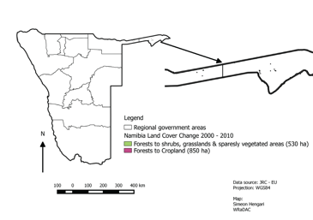
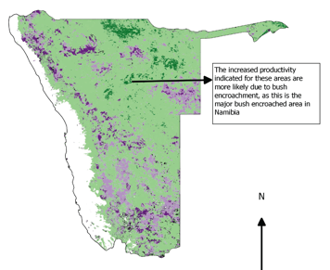
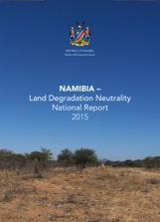
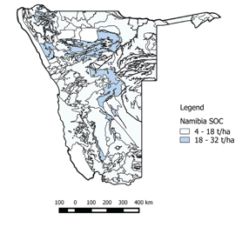
Monitoring and Evaluation
Joint progress indicators for each of the Rio Conventions adopted and Land Degradation Neutrality monitored in Namibia and targets in place
Land Use / Cover Change
Land Productivity
Soil Organic Carbon stocks

Slide 10
Examples of on-the-ground implementation
Intervention | Impacts
 | Biodiversity | Climate Change | Desertification
Climate Smart Agriculture Eg. Drip irrigation, conservation agriculture, agro-forestry practices | Improved plant and soil organisms diversity Nutrient cycling and enhanced soil moisture Improved ecosystem health | More efficient water use Increased carbon stocks in soil Reduced vulnerability of rural communities to drought events | Improved soil productivity and crop yields Reduced soil erosion Improved vegetative cover
2. Communal Conservancy Programme and wildlife-based tourism | Improved species abundance Reduced poaching Improved local level monitoring of ecosystem health Human wildlife conflict mitigation | More efficient water use Reduced vulnerability of rural communities to drought events | Income and livelihood diversification for rural communities Reduced pressure on ecosystems compared to livestock farming Empowerment of rural communities
3. De-bushing Programmes | Improved availability of perennial grasses, plant and soil organisms diversity Improved ecosystem health and habitats for livestock and willdife | Reduced depletion of water table Energy generation from biomass Potential for sustainable charcoal production | Improved rangeland productivity and carrying capacity
Climate Smart Agriculture

Slide 11
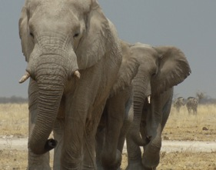
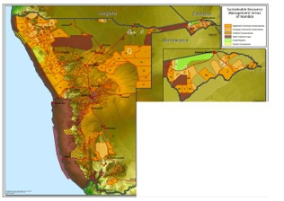
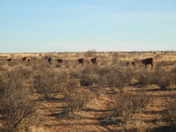
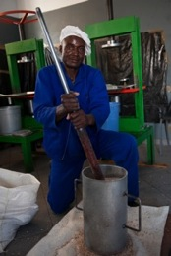
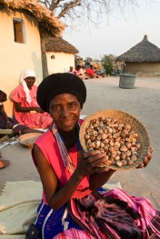
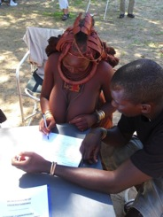
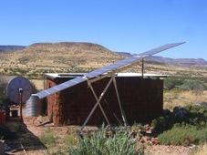
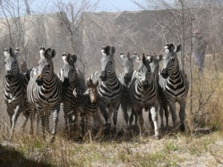
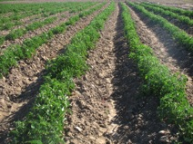
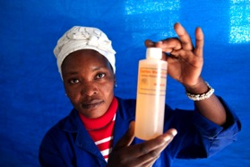

Slide 12
Way forward
Harmonization of the three national committees on climate change, biodiversity and sustainable land management
Continued joint awareness raising on Rio Conventions with particular focus on rural communities
Increased research and scientific cooperation on Rio Conventions and establishment of improved bio-physical monitoring systems
Scaling up of on-the-ground measures for maximum contribution to poverty eradication and improved ecosystem health

Slide 13
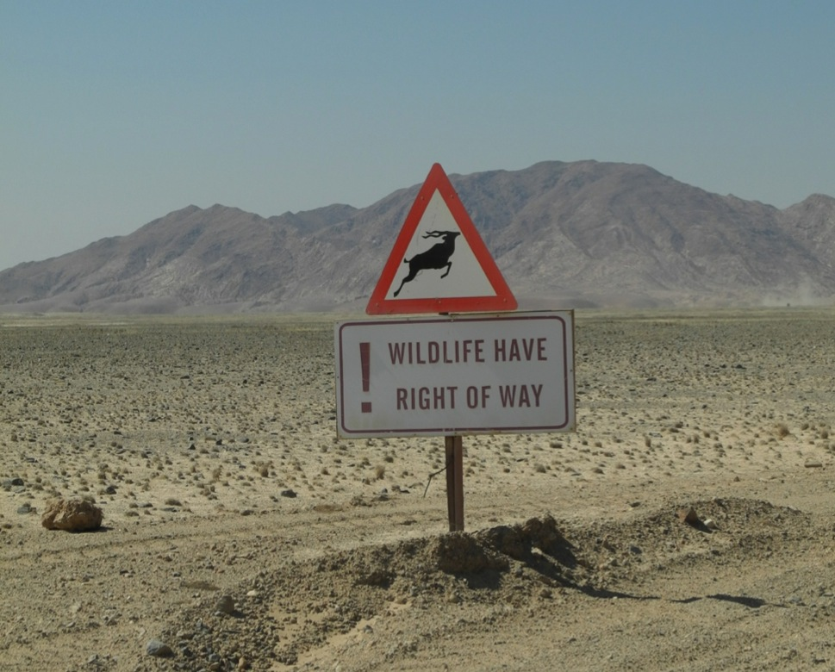

Thanking you for your attention!

